Slide 1
Sulfur Emissions
By: Junta Callahan and Ethan Norton

Slide 2
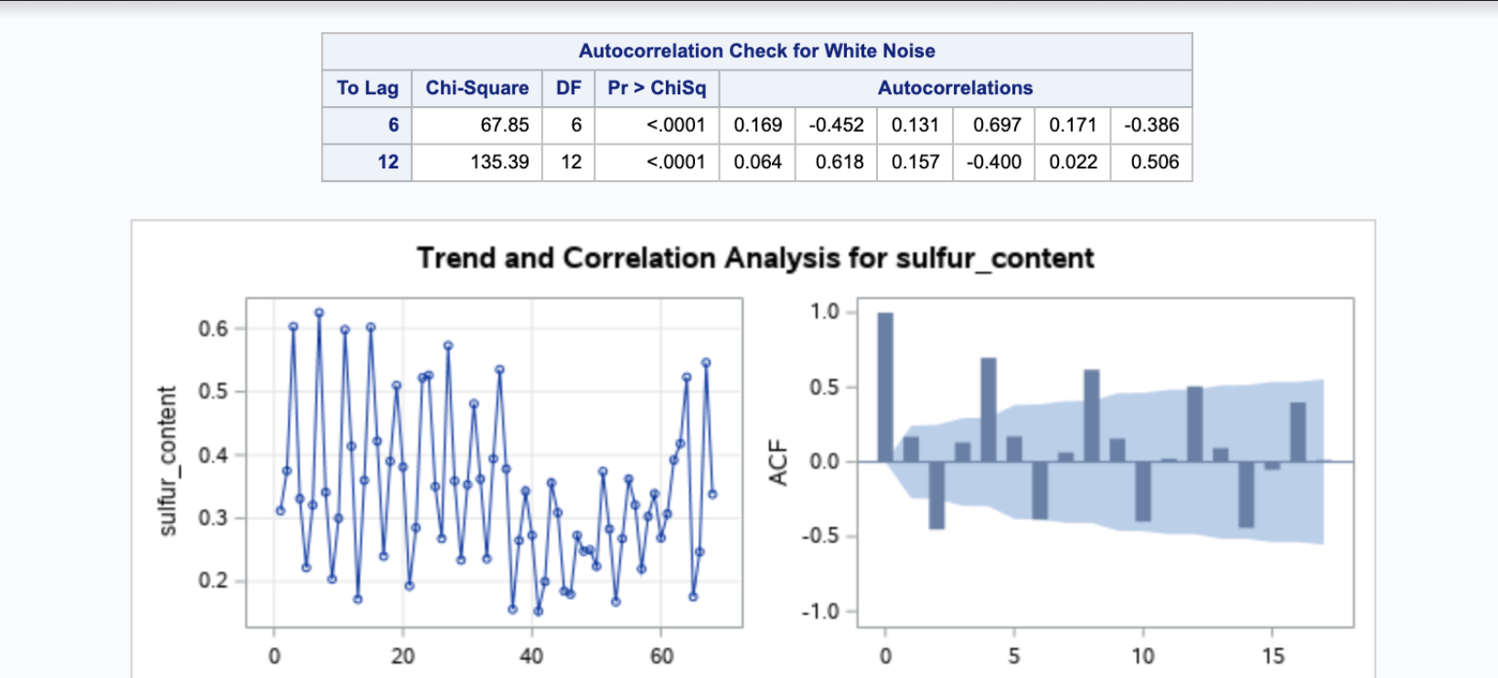
Background and Preliminary Analysis
Time Series Data: U.S. Environmental Protection Agency S02 pollution on November 11th, 2020.
Seasonality -Yes, our data contains quarterly data by seasons. Also can see regular interval "humps."
Trend - No, no steady increase or decrease over time
Stationary - No, some Lags in the ACF plot are out of the shaded region. Also conducted a Ljung-Box test and rejected the null hypothesis.

Slide 3
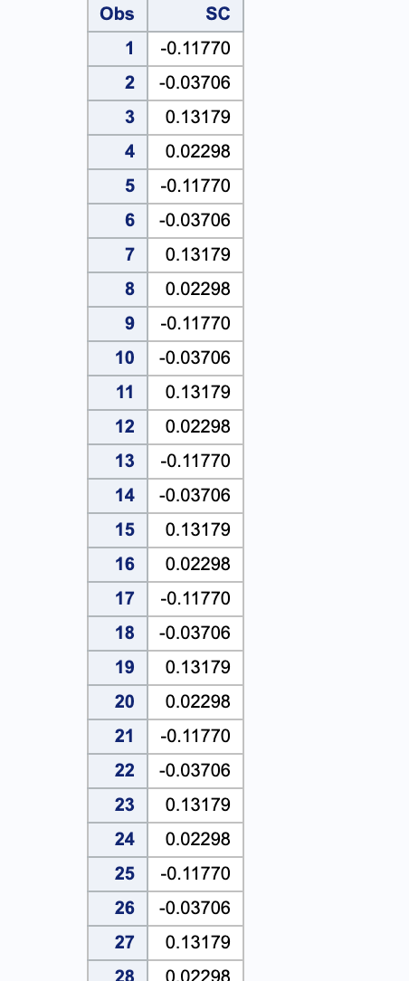
Classical Decomposition
This image on the right displays the various seasonal coefficients.

Slide 4
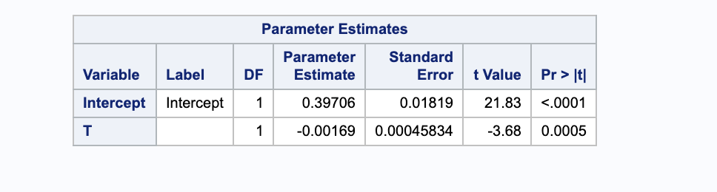
Classical Decomposition
This image below displays the linear trend regression line estimate. For every increase in t (which is time) the sulfur content decreases by .00169.

Slide 5
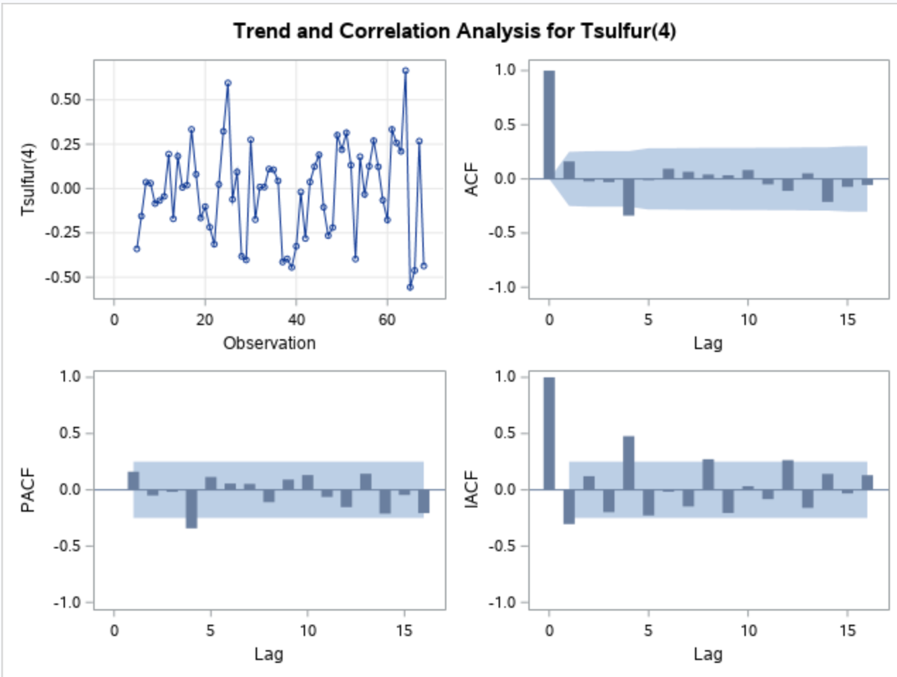
ARIMA Modeling
We decided…
D=1 as the data contains seasonality.
d= none needed as ADF p-value less than .05.
Q=1 since ACF plot is oscillating(negative correlation).
P=0 since rule of thumb(P+Q is less than or equal to 1).
p= 1 one lag out of PACF plot.
q=1 one lag out of ACF plot.
Notes:
We first took D as in the time series data there will be seasonality. And then we conducted an ACF test to see if a difference is needed for d. Finally, we found out p-value is less than .05. Therefore, we didn’t have to take a difference anymore for lower case d.

Slide 6
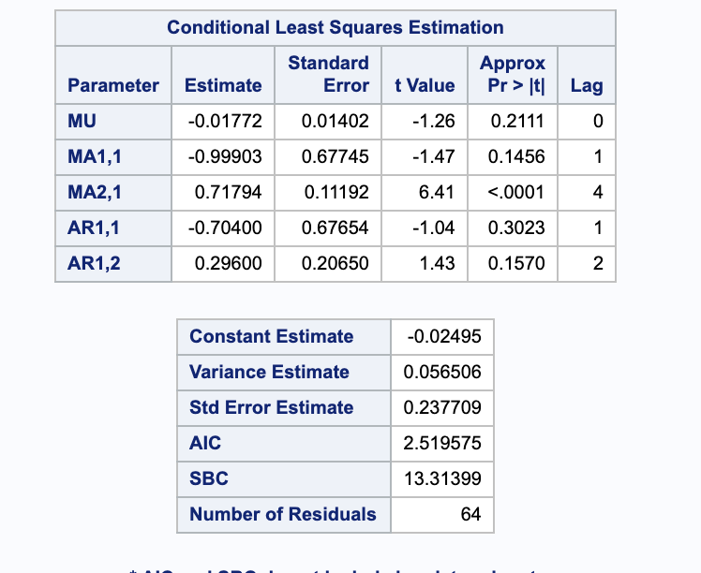
Forecasting (finding the best fit ARIMA model)
ARMA (2,1)x(0,1)4

Slide 7
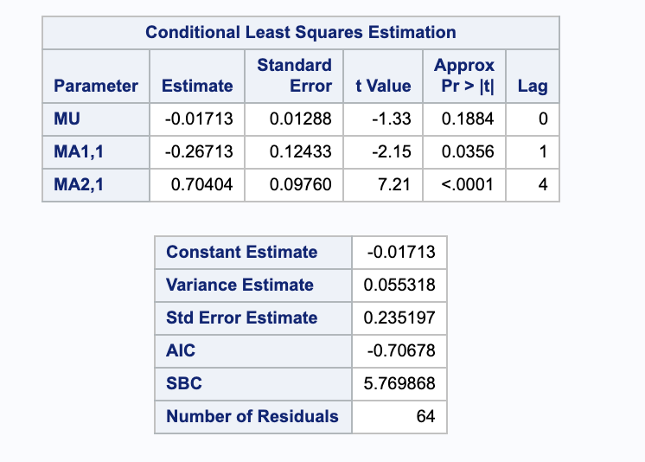
Forecasting (finding the best fit ARIMA model)
ARMA(0,1)x(0,1)4

Slide 8
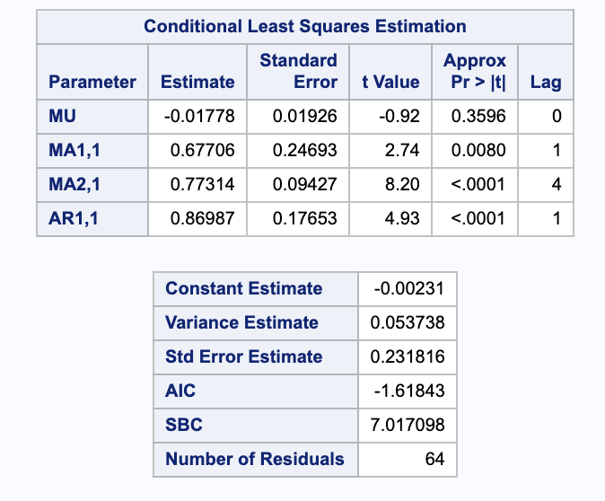
Forecasting (finding the best fit ARIMA model)
ARMA(1,1)x(0,1)4

Slide 9
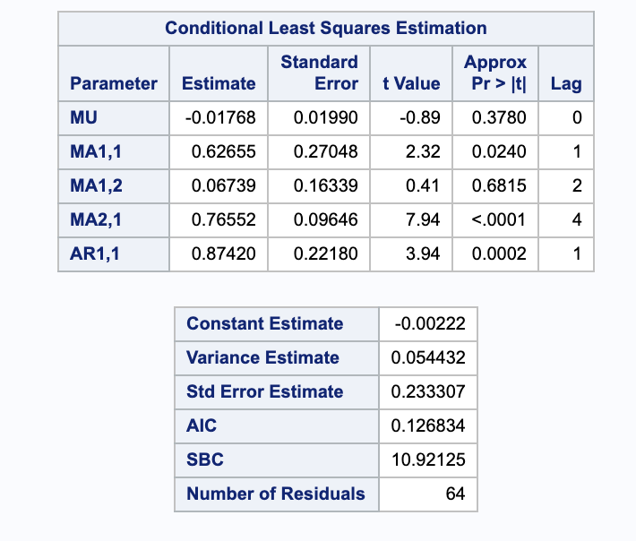
Forecasting(finding the best fit ARIMA model)
ARMA(1,2)x(0,1)4

Slide 10
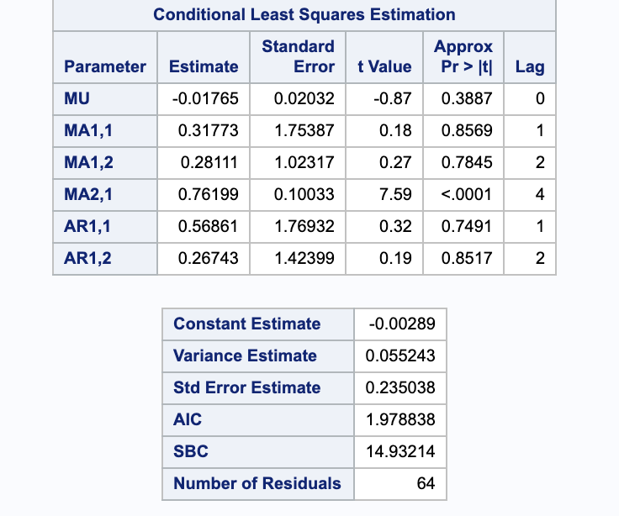
Forecasting (finding the best fit ARIMA model)
ARMA(2,2)x(0,1)4

Slide 11
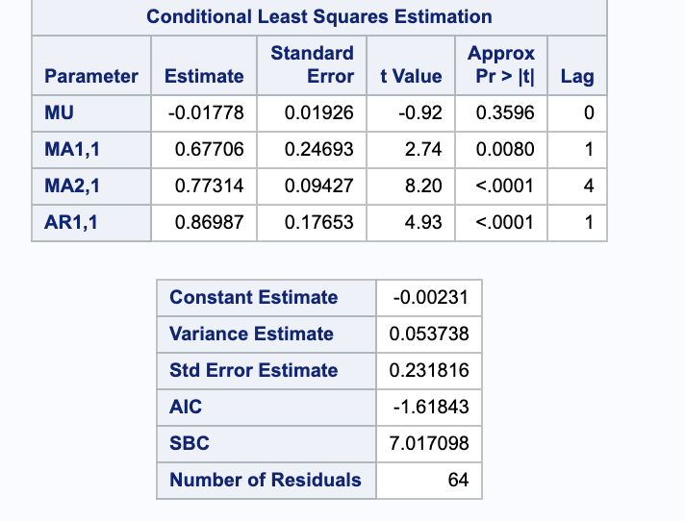
The two best ARIMA Models.
ARMA(1,1)x(0,1)4 - Best
ARMA(0,1)x(0,1)4

Slide 12
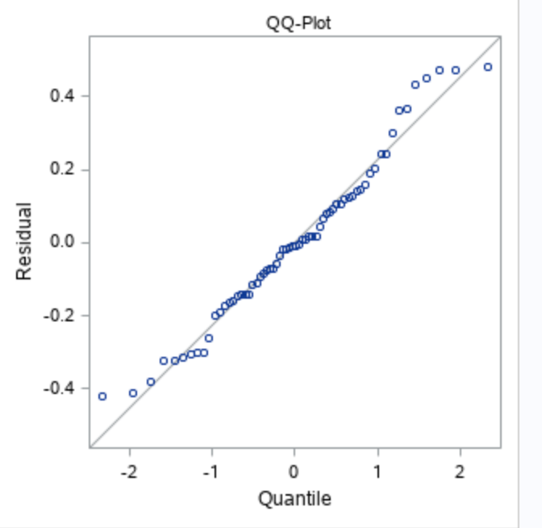
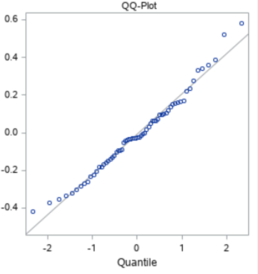
The two best ARIMA models (QQ plot).
ARMA(1,1)x(0,1)4
ARMA(0,1)x(0,1)4

Slide 13
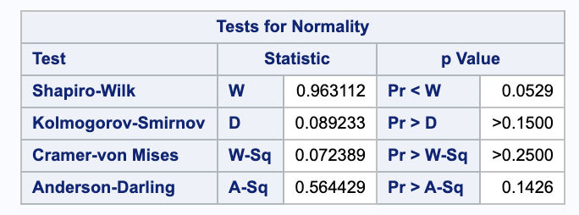
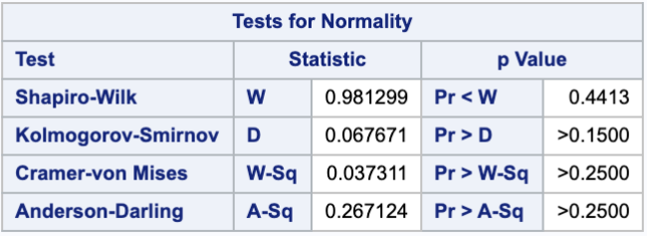
The two best ARIMA models (Shapiro-Wilk test).
ARMA (1,1)x(0,1)4 ARMA(0,1)x(0,1)4

Slide 14
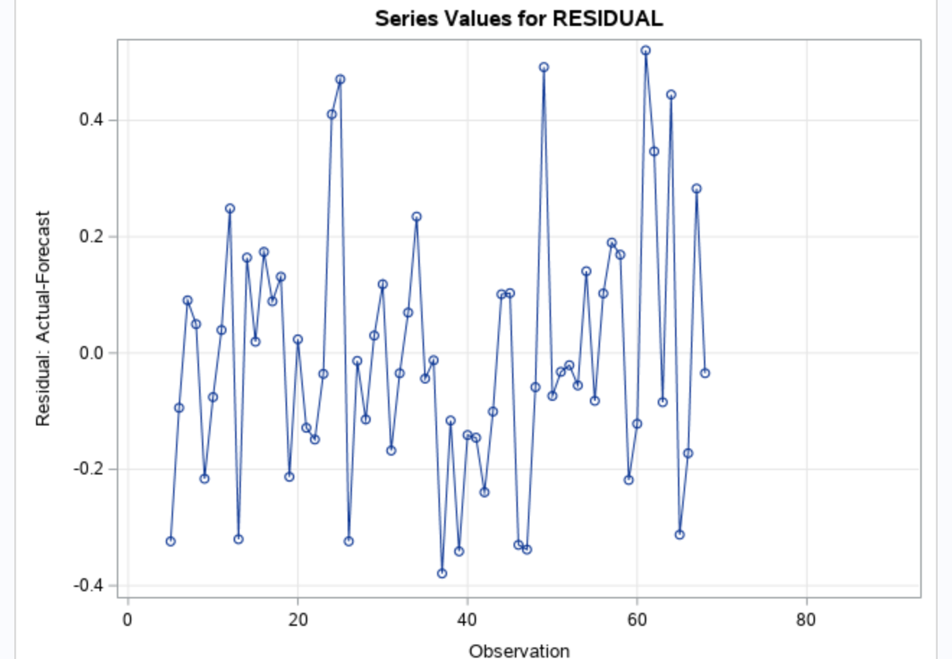
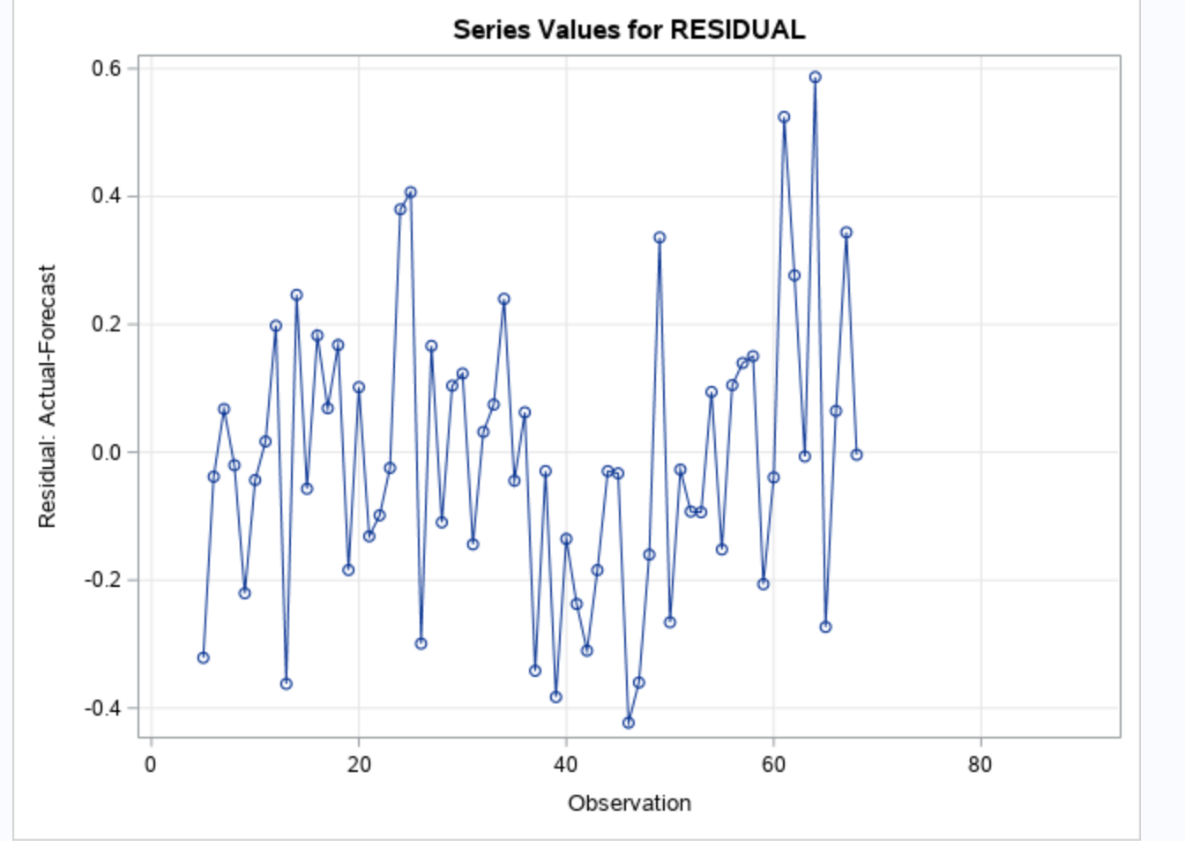
The two best ARIMA models (Residual plot).
ARMA(1,1)x(0,1)4
ARMA(0,1)x(0,1)4

Slide 15
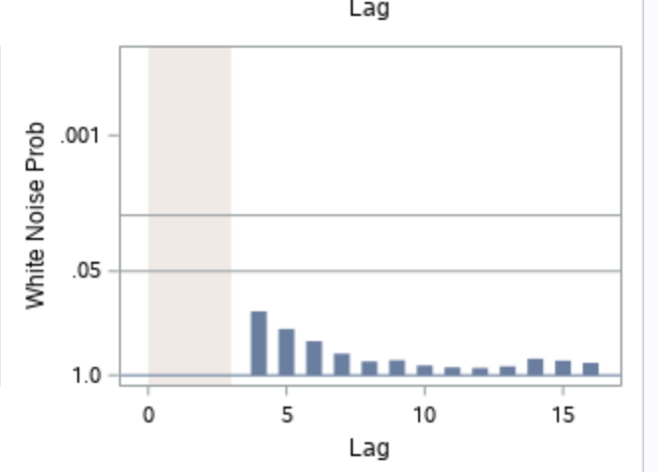
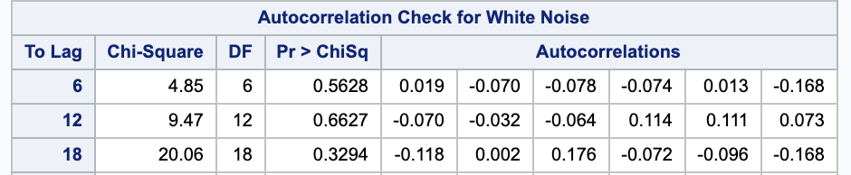
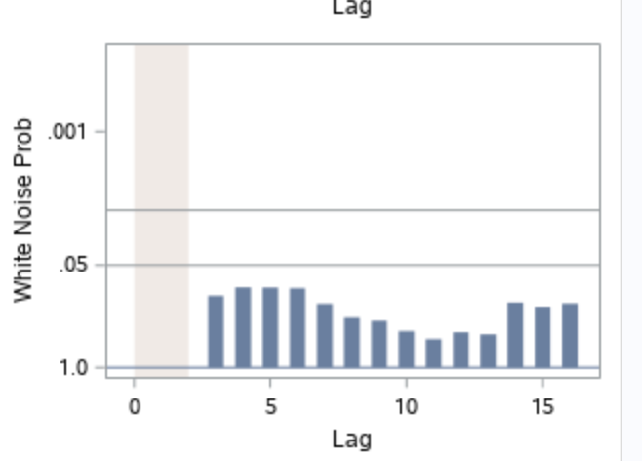
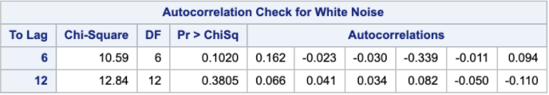
The two best ARIMA models ( White Noise Probability).
ARMA (1,1)x(0,1)4
ARMA(0,1)x(0,1)4
Notes:
Conducted a Ljung-Box test for the errors/ residuals
Based on both p-values we failed to reject the null hypothesis therefore the errors/residuals are uncorrelated
We can also use the white noise probability plot, where each lag represents the p-value… none of the p-values goes lower than .05
Has residual conditions met, therefore we reject the null hypothesis. No need for Ljung-Box Test.

Slide 16
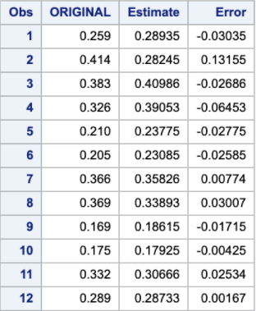
Classical Decomposition
The image to the right displays the classical
decomposition.

Slide 17
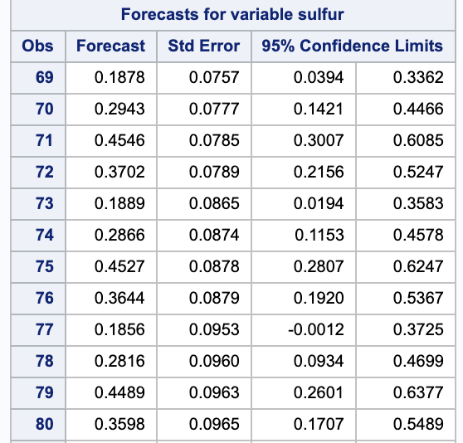
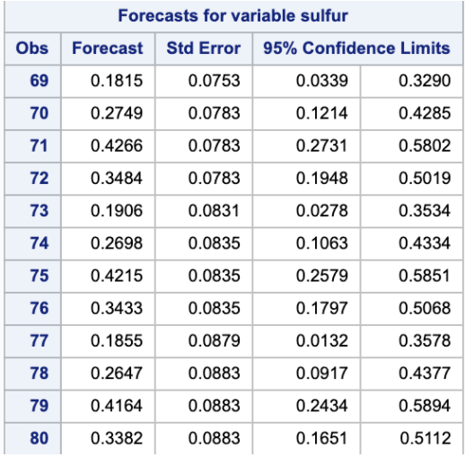
The two best ARIMA models (Forecasting).
ARMA(1,1)x(0,1)4 ARMA(0,1)x(0,1)4

Slide 18
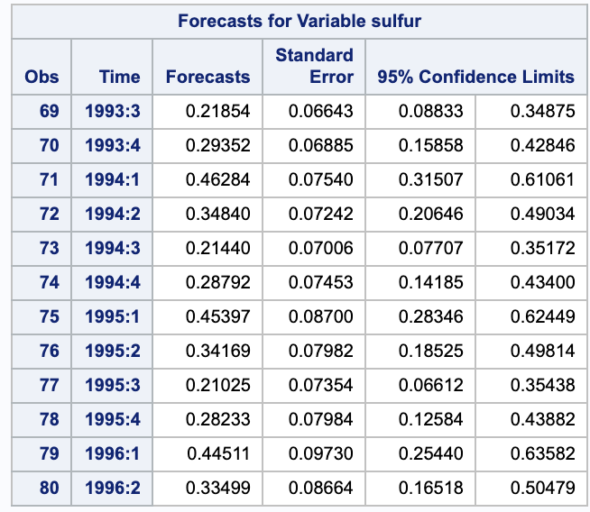
Holt-Winters exponential smoothing.
Used Winters function for exponential smoothing.
Notes:
proc hpf data = project lead=12 print=all seasonality=4;
id Date interval=Qtr;
forecast sulfur / model= winters;
run;
Holt-Winters exponential smoothing (if there is seasonality)

Slide 19
SSE Values
Holt-Winters exponential smoothing
0.2869
ARMA(1,1)x(0,1)4
0.0714
ARMA(0,1)x(0,1)4
0.054
Decomposition
0.026

